Slide 1



Capstone Project

Slide 2
RllRealestates

Slide 3
ABSTRACT…
Real estate portal The user enters and registers and then adds his data and enters the real estate and then adds a property and the user buys or sells a property and there is a real estate broker

Slide 4
The Problems
lack of communication
Saving time and effort

Slide 5
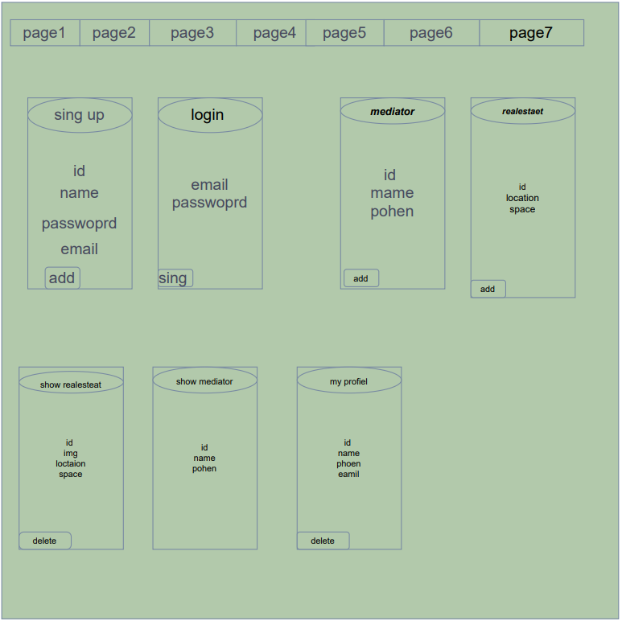
WIREFRAME..

Slide 6
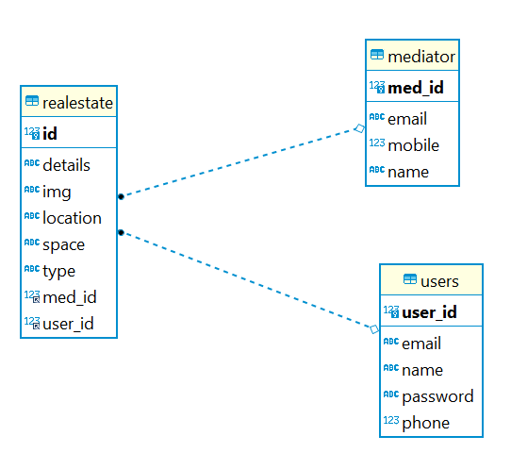

Slide 7
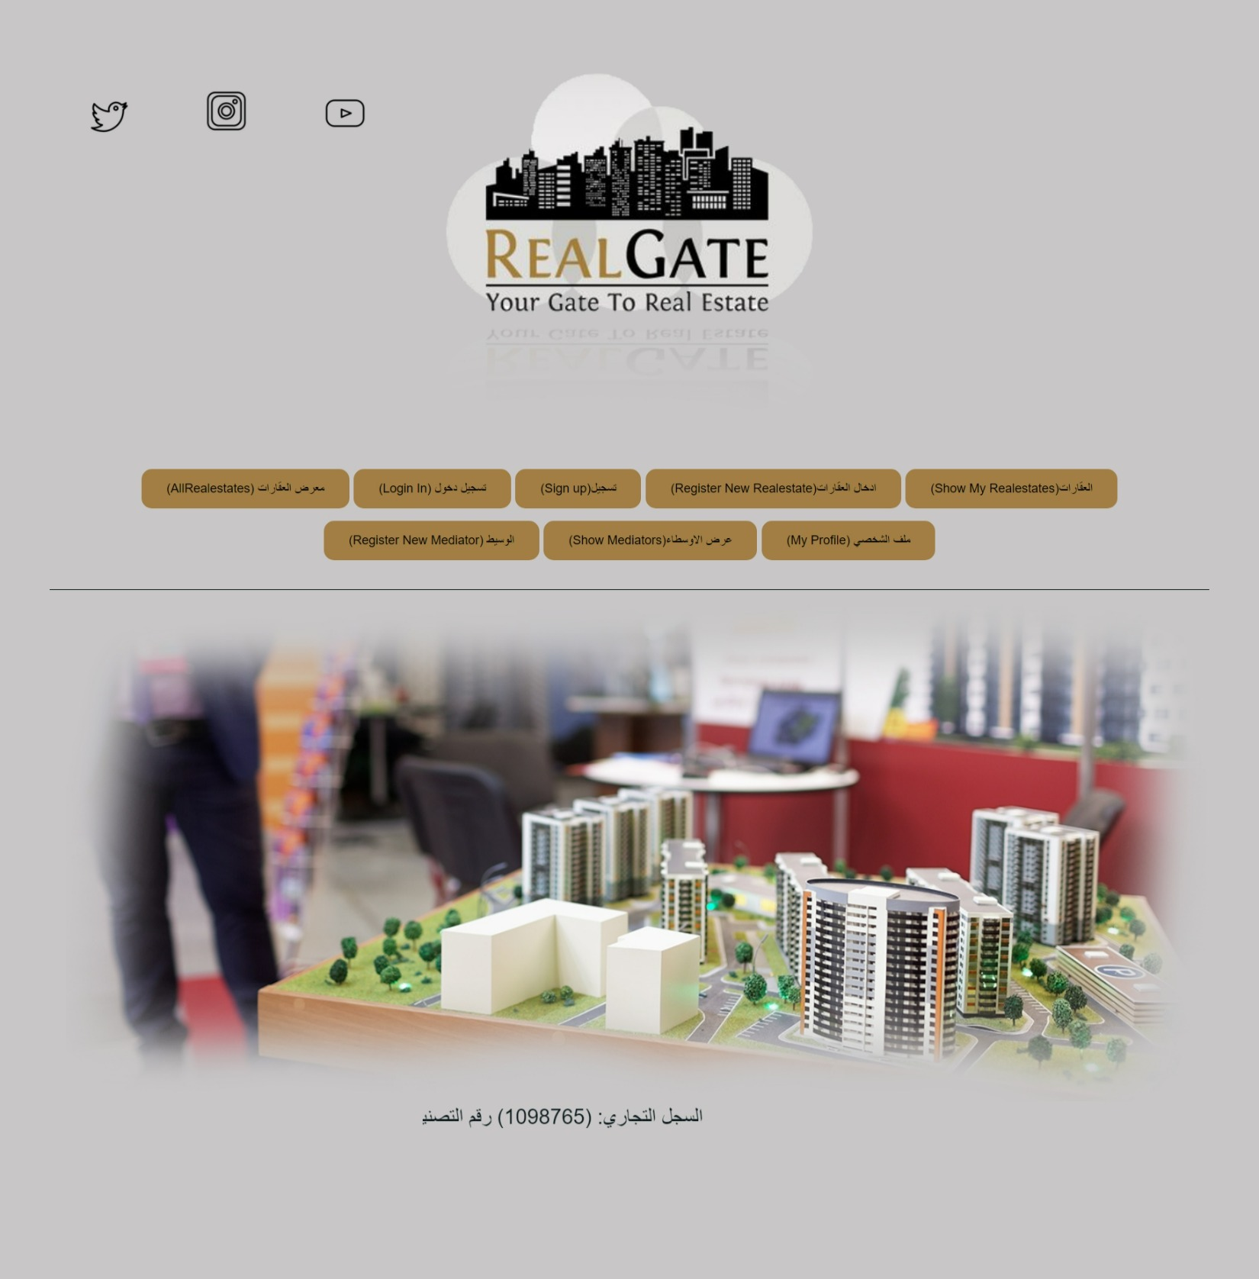

Slide 8
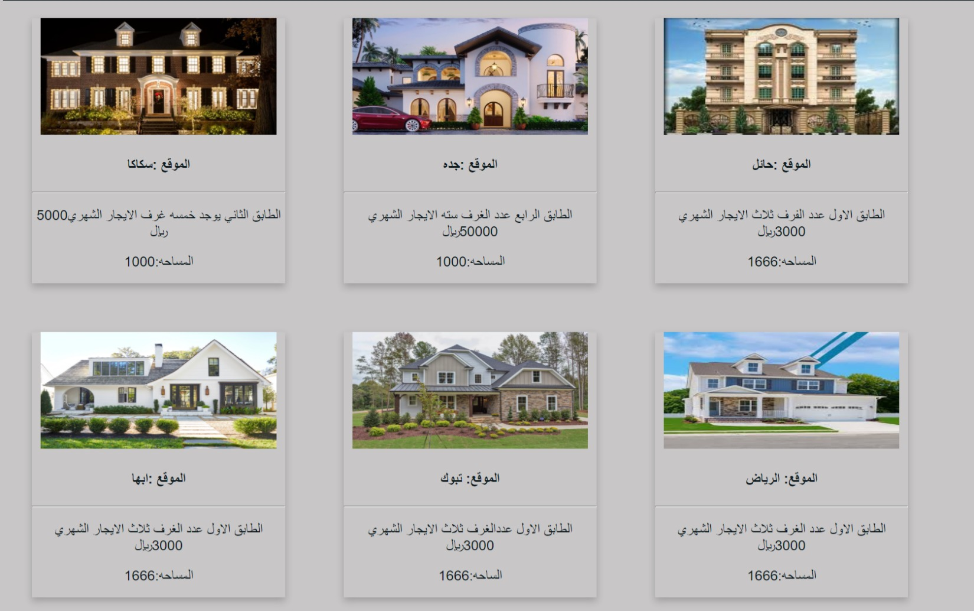

Slide 9
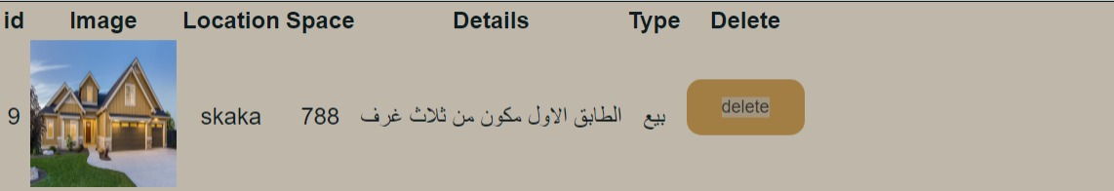

Slide 10
Technologies used
The front was creaated using react javascript and html and styled using css
The back was created using mysql and java spring

Slide 11
What was the most difficult part of the project
It is not difficult, but the front is more complicated and also the login page
What was your favorite part of the project
Db and creat tables
What are the new things you leating this aplication
Build a complete a full stack web application

Slide 12

Thank you

